Slide 1
Empathy in Conversational systems
Sahand Sabour 2020280401
Marcin Malinowski 2020380003
2021/03/29

Slide 2
Table of contents
Introduction to chatbots
The history of empathy in chatbots
Empathy for mental health support
Future Direction

Slide 3
Introduction to chatbots

Slide 4
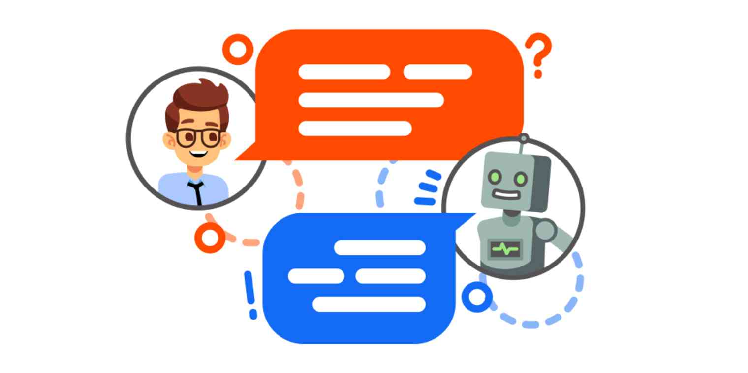
What are chatbots?
What are chatbots?
AI programs that can simulate a human conversation
Most promising form of human-machine interactions.
They can be used to accomplish tasks, recommend products and most importantly have a normal conversation (open-domain).

Slide 5
What is a good chatbot?
The main objective of building a dialogue system is to model human behavior.
A main attribute of human conversations is the ability to express empathy (共情).
Empathy in behavioral studies: to perceive, understand and respond appropriately to the situation's context and the implicit emotions.
I lost my father today. (implicit emotion: sad) → Sorry to hear that...
I finally won the first prize. (implicit emotion: happy) → I bet you're really proud!

Slide 6
The history of empathy in chatbots

Slide 7
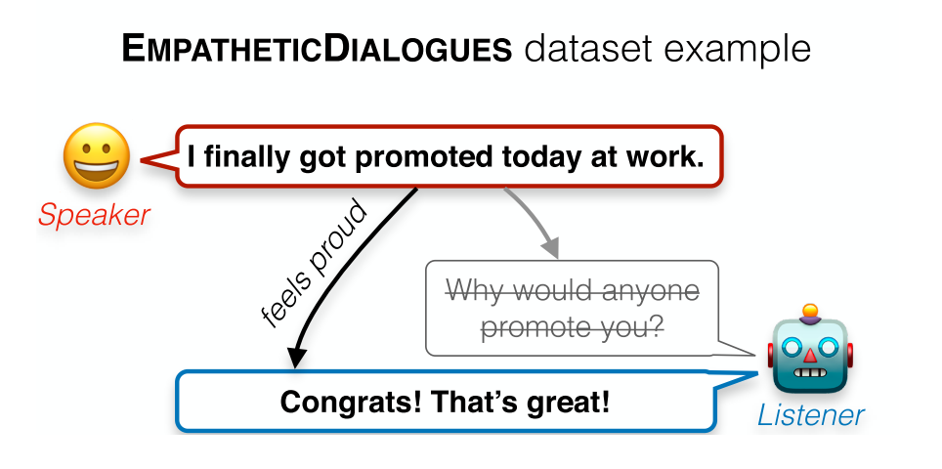
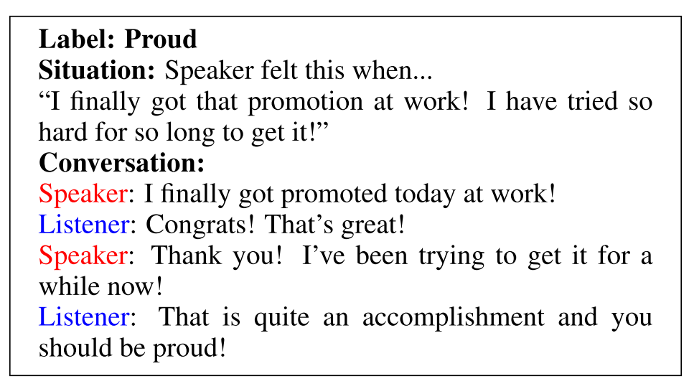
Empathetic Dialogues (2018-2019)
Empathy: recognizing the other person's feelings and responding correspondingly.
They propose a dataset of empathetic conversations:
Each conversation has an emotion label and the context of the situation.
The conversations are around 5-8 turns of dialogue between workers.
Rashkin, H., Smith, E., Li, M. Boureau, Y., 2019. Towards Empathetic Open-domain Conversation Models: A new benchmark and dataset. arXiv preprint arXiv:1811.00207.

Slide 8
Happybot (2019)
Previous work focused on conditioning the output on a given emotion or user's current emotional state.
They propose a framework that conditions the output by predicting how the user would feel after this response (look-ahead) with a sentiment predictor.
Their Model:
Policy: Bi-GRU as encoder and GRU with dot product attention as generator.
Reward: BERT as a sentiment predictor. Trained on the SST-2 and ED Dataset.
Training: MLE, RL algorithm or both on 3 datasets → ED, DD and PC
Shin, J. Xu, P., Madotto, A., Fung, P., 2019. HappyBot: Generating Empathetic Dialogue Responses by Improving User Experience Look-ahead. arXiv:1906.08487.

Slide 9
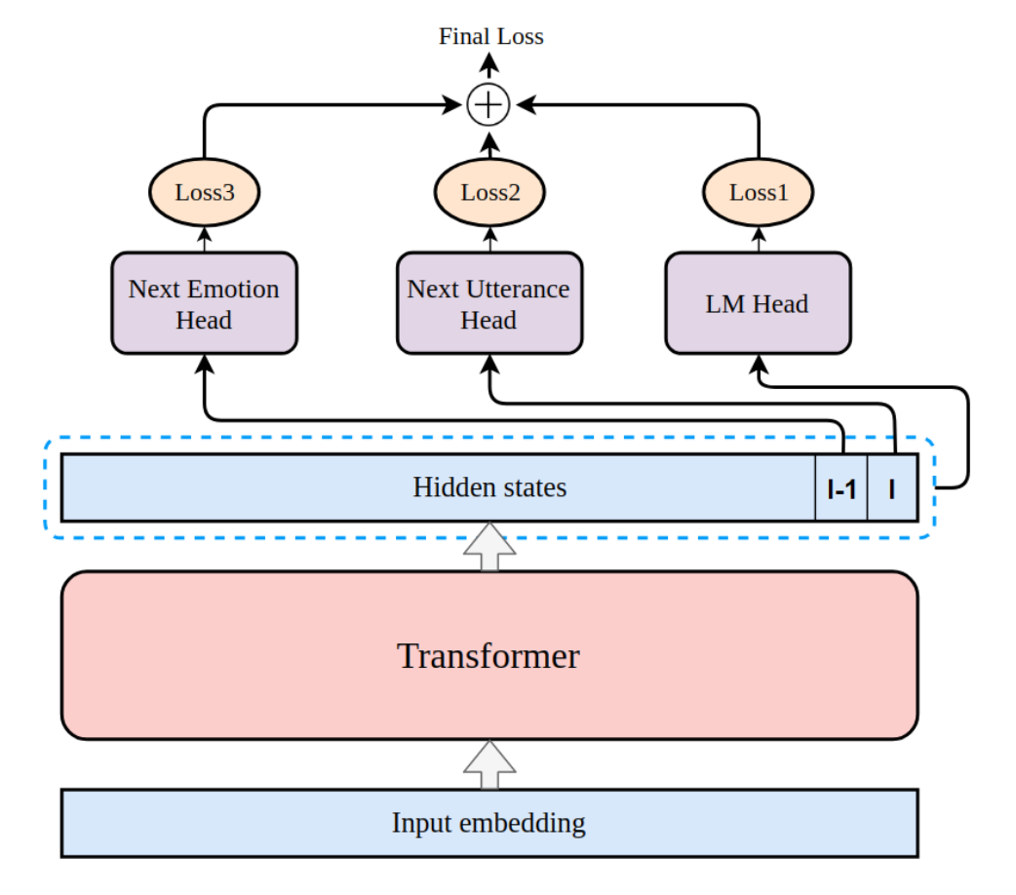
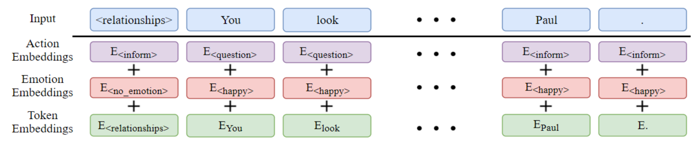
Emptransfo (2020)
They proposed that utilizing the history of emotions and other metadata can lead to more empathetic responses.
Their approach uses a multi-head transformer architecture.
Trained on DailyDialog dataset → topics, actions and emotions.
Zandie, R., Mahoor, M., 2020. EmpTransfo: A Multi-head Transformer Architecture for Creating Empathetic Dialog systems. arXiv:2003.02958.

Slide 10
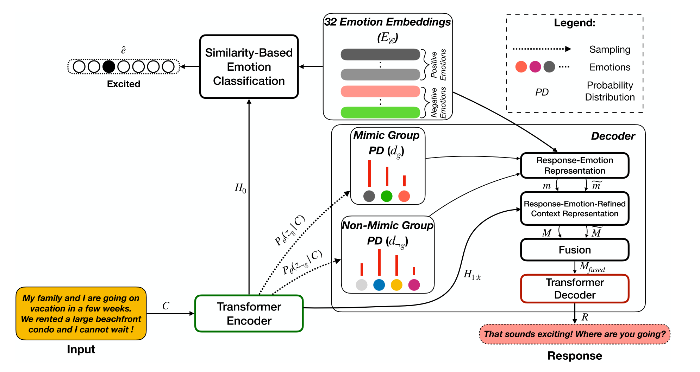
Mime (2020)
They propose that an empathetic response should mimic the user's emotion to a degree, depending on the sentiment and content of the user utterance.
Positive emotions are usually responded with positive emotions.
Negative emotions require emotions that agree with and comfort the user.
Majumder, N., Hong, P., Peng, S., Lu, J., Ghosal, D., Gelbukh, A., Mihaleca, R., Poria, S., 2020. MIME: MIMicking Emotions for Empathetic Response Generation. arXiv:2010.01454.

Slide 11
Open areas of research
Up to this point, the state-of-the-art models focused on producing empathetic responses and there's a lack of comparison between them. Why?
Empathy is a complex construct and it is defined in different ways.
In order for a logical comparison, the work on this field has to agree on a definition.
But why do we, as humans, have empathy for others?
To demonstrate our understanding of the situation.
To provide support and affirmation.
How about creating chatbots that use empathy to provide support?

Slide 12
Empathy for mental health support

Slide 13
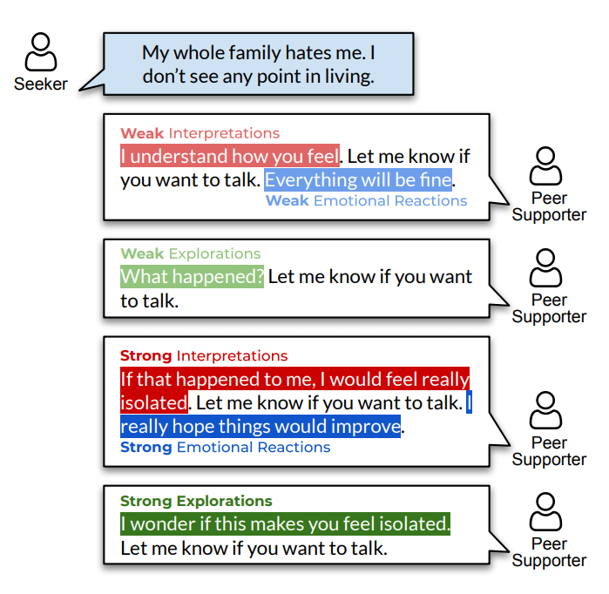
EPITOME (2020)
They cover empathy in text based online mental health support
Mechanisms of expressed empathy:
Emotional reaction
Interpretation
Exploration
Each mechanism has different levels:
None (0)
Weak (1)
Strong (2)
Sharma, A., Miner, A.S., Atkins, D.C. and Althoff, T., 2020. A Computational Approach to Understanding Empathy Expressed in Text-Based Mental Health Support. arXiv preprint arXiv:2009.08441.

Slide 14
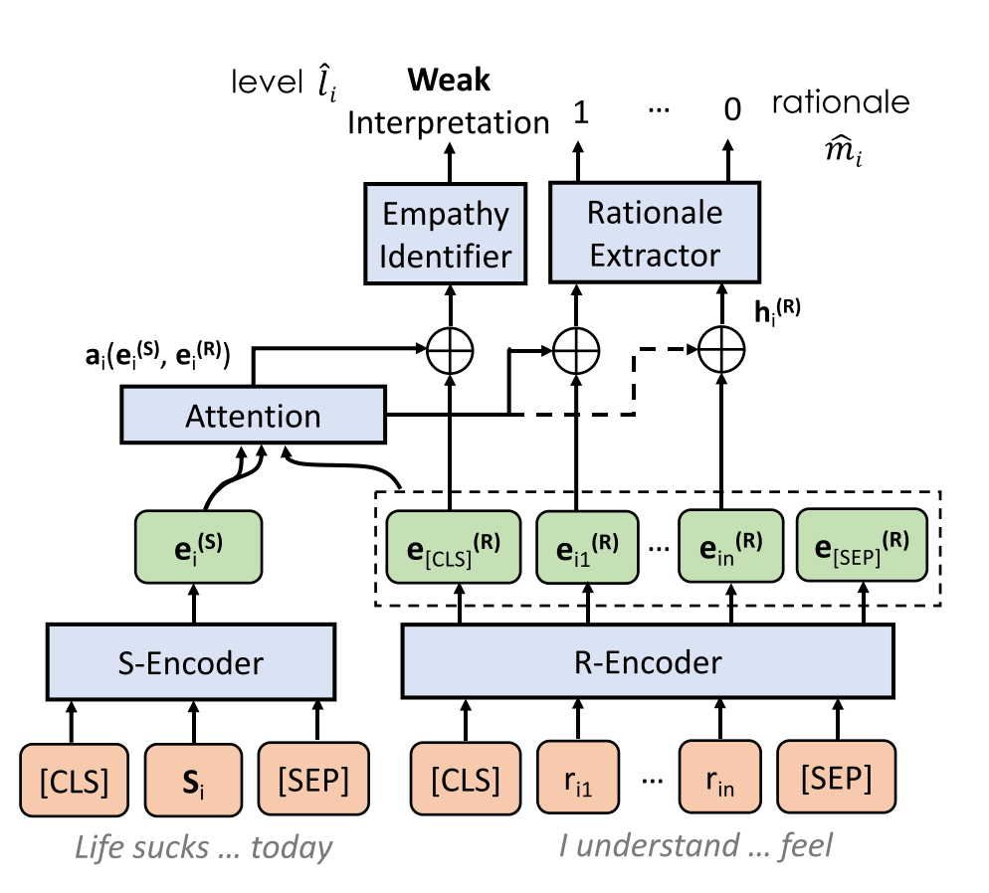
EPITOME (2020)
Classification model with rationale for each of the mechanisms
Two datasets: Reddit (discussion website) TalkLife (peer support mental health network)
Sharma, A., Miner, A.S., Atkins, D.C. and Althoff, T., 2020. A Computational Approach to Understanding Empathy Expressed in Text-Based Mental Health Support. arXiv preprint arXiv:2009.08441.

Slide 15
issues with this topic
Ethical issues
Controlling the generation results of machine learning models is challenging.
A model that is used for support in mental health could:
Generate harmful, toxic or inconsiderate responses.
Some responses could discourage the user from conversing with the model.
In more extreme cases, such as self-harm, they could lead to irreversible consequences.
The current approaches only focuses on negative emotions.
Mental health support is a more specific branch of emotional support.
A better idea would be to use empathy for emotional support.

Slide 16
Future Direction

Slide 17
Empathy for emotional support
Local support groups provide an opportunity for 5-10 people to converse and share their similar experiences. Online support groups allow for thousands of people to connect and share their experience, which provides a more effective experience.
However, many posts on these online forums may go unnoticed, which discourages the user from sharing their situation in the future.
We could use publicly available datasets, such as Reddit, add additional annotation to give meaning to each post, and ultimately, to create a model that utilizes empathy for providing effective emotionally supportive responses.
Proposed topic: Empathy for Emotional Support
Preece, J., 1999. Empathic communities: Balancing emotional and factual communication. Interacting with computers, 12(1), pp.63-77.
De Gennaro, M., Krumhuber, E.G. and Lucas, G., 2020. Effectiveness of an empathic chatbot in combating adverse effects of social exclusion on mood. Frontiers in psychology, 10, p.3061.

Slide 18
References
Majumder, N., Hong, P., Peng, S., Lu, J., Ghosal, D., Gelbukh, A., Mihalcea, R. and Poria, S., 2020. MIME: MIMicking Emotions for Empathetic Response Generation. arXiv preprint arXiv:2010.01454.
Shin, J., Xu, P., Madotto, A. and Fung, P., 2019. Happybot: Generating empathetic dialogue responses by improving user experience look-ahead. arXiv preprint arXiv:1906.08487.
Rashkin, H., Smith, E.M., Li, M. and Boureau, Y.L., 2018. Towards empathetic open-domain conversation models: A new benchmark and dataset. arXiv preprint arXiv:1811.00207.
Sharma, A., Miner, A.S., Atkins, D.C. and Althoff, T., 2020. A Computational Approach to Understanding Empathy Expressed in Text-Based Mental Health Support. arXiv preprint arXiv:2009.08441.
Preece, J., 1999. Empathic communities: Balancing emotional and factual communication. Interacting with computers, 12(1), pp.63-77.
De Gennaro, M., Krumhuber, E.G. and Lucas, G., 2020. Effectiveness of an empathic chatbot in combating adverse effects of social exclusion on mood. Frontiers in psychology, 10, p.3061.
Zandie, R. and Mahoor, M.H., 2020. Emptransfo: A multi-head transformer architecture for creating empathetic dialog systems. arXiv preprint arXiv:2003.02958.

Slide 19
Thank you for listening Any questions?

